Slide 1
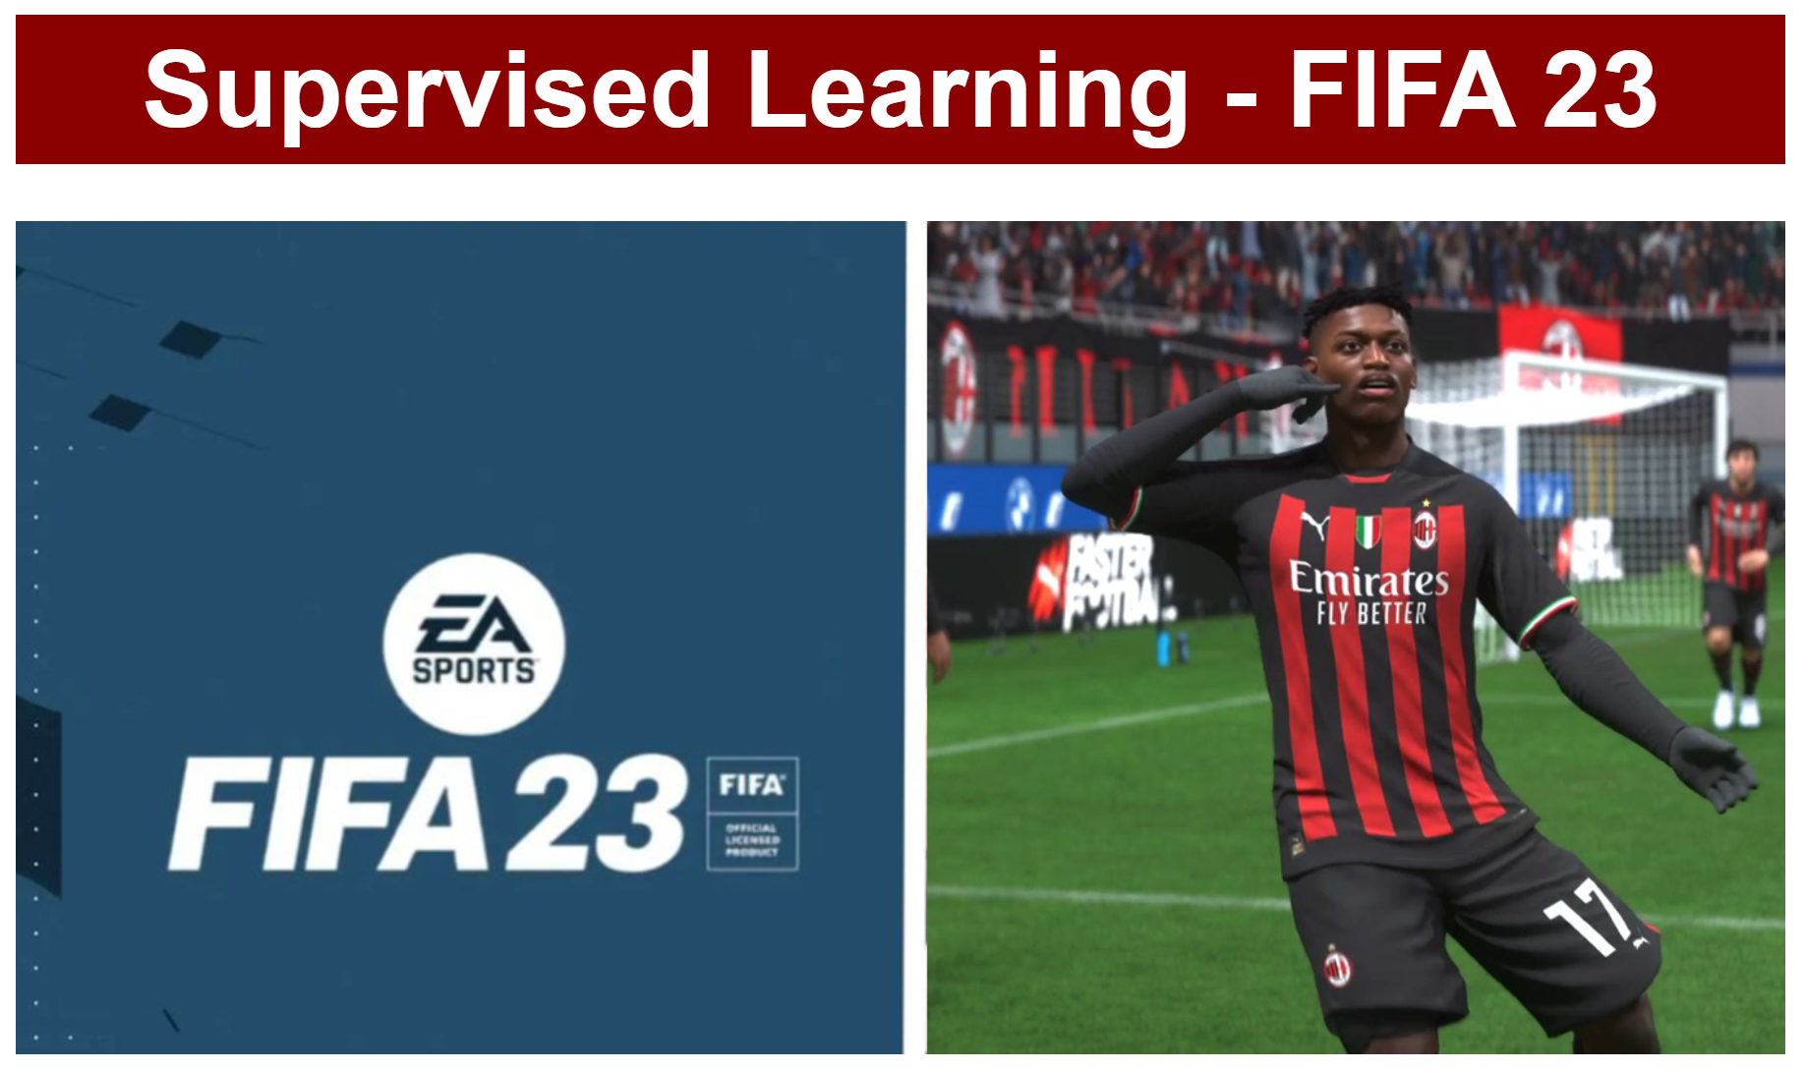
DTSA 5509
Final Project

Slide 2
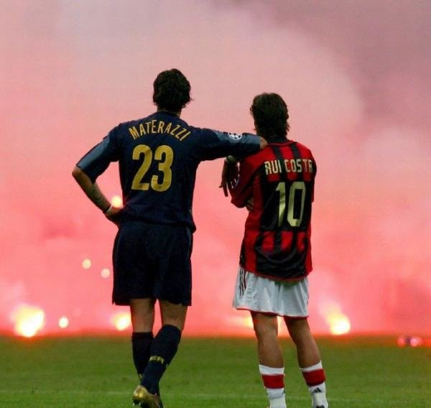
Project Agenda
1. Project Introduction
2. Data Cleaning
3. Exploratory Data Analysis
4. Regression Modeling
5. Conclusion

Slide 3
1. Project Introduction
Dataset
FIFA23 1st Edition Player Database
From Kaggle Website
Players’ Information and Attributes
Goal
Predict Players’ Market Value
in the Game by
Supervised Learning Methods

Slide 4
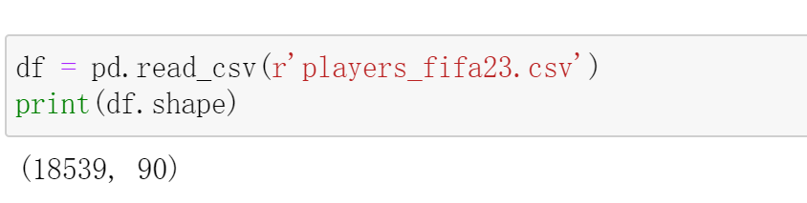
2. Data Cleaning
Players
18539
Attributes
90

Slide 5
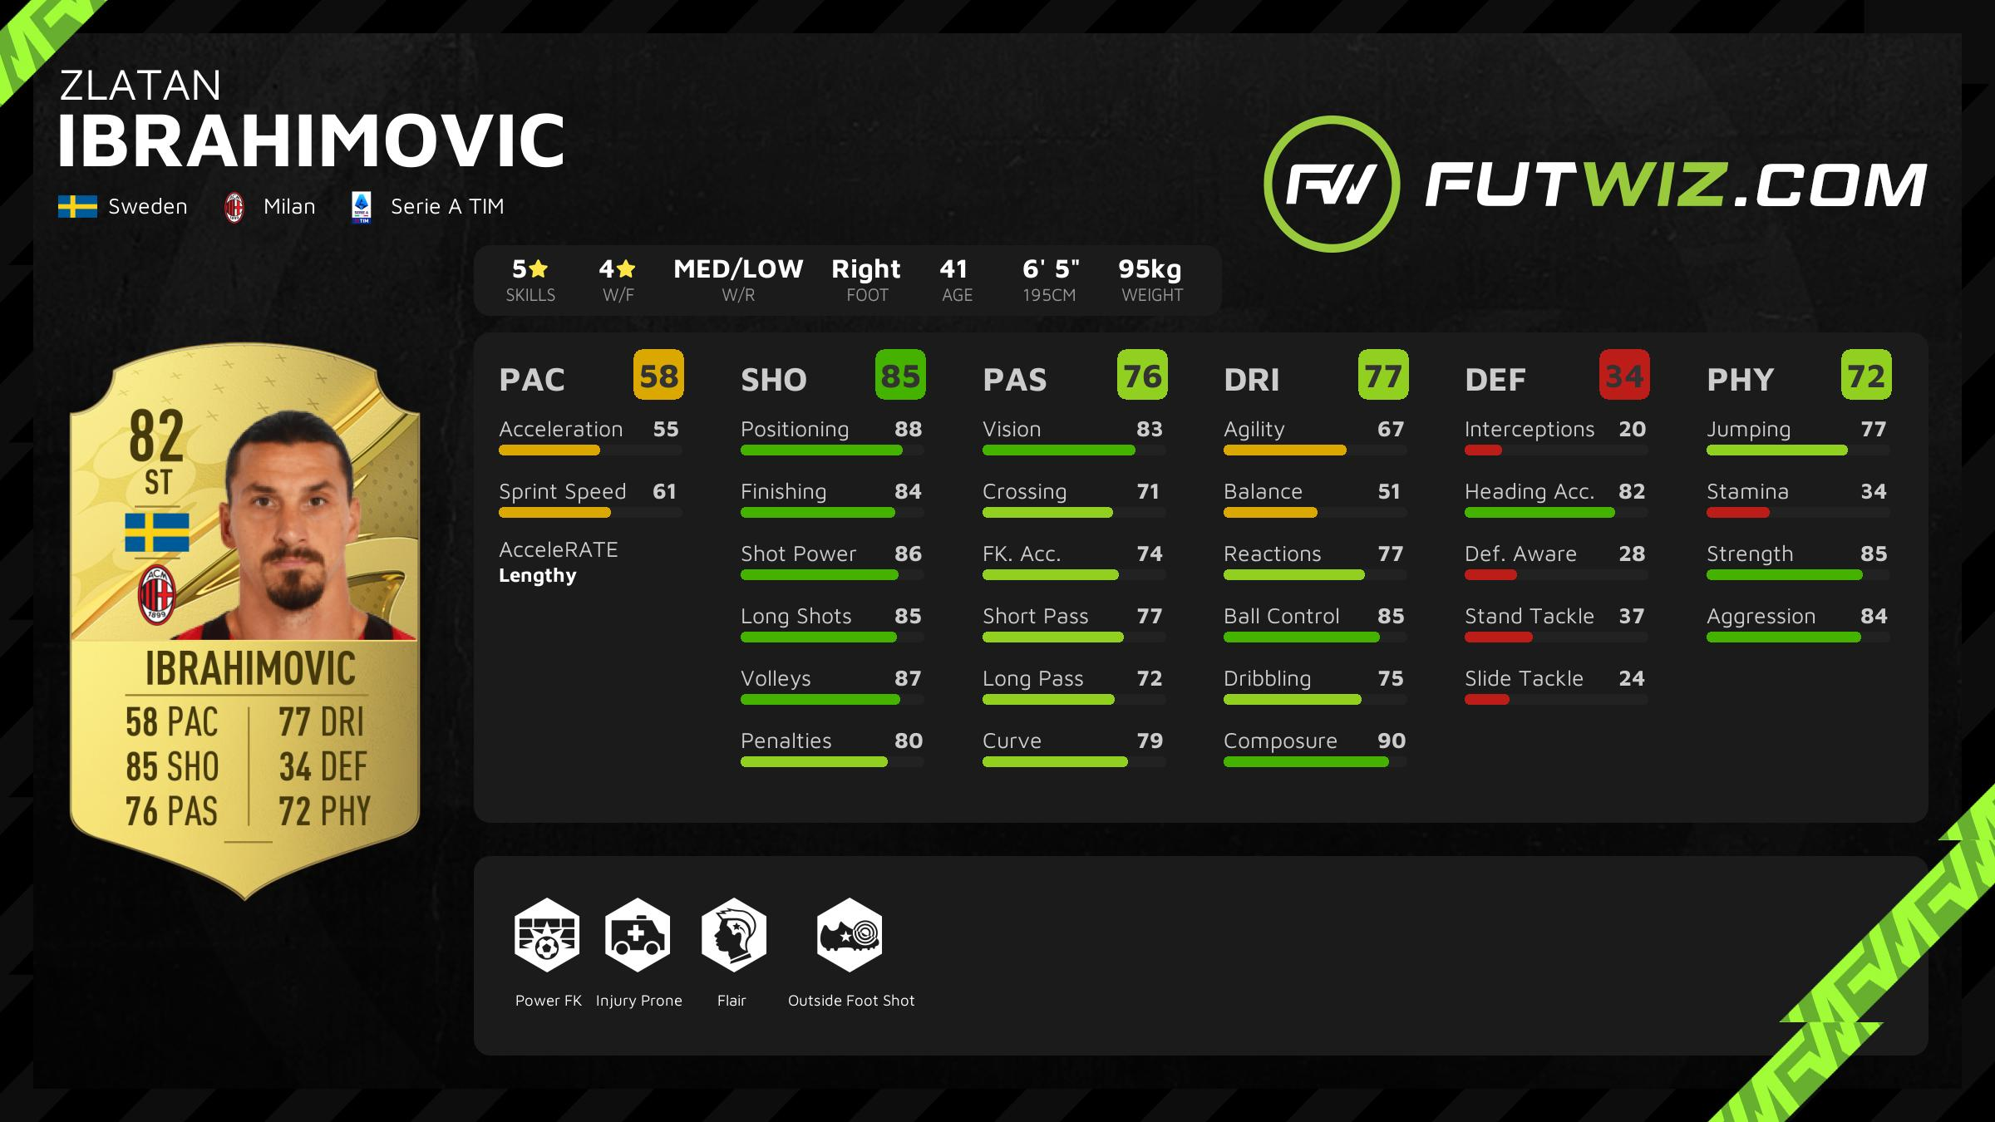
2.1 Feature Description
Player Details
Specific Attributes
General Attributes

Slide 6
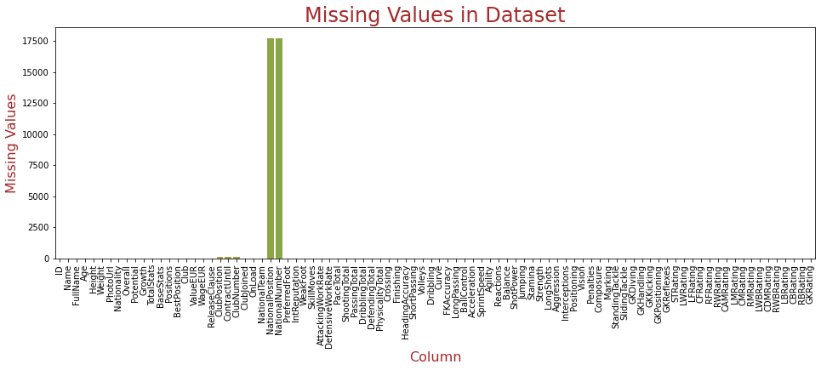
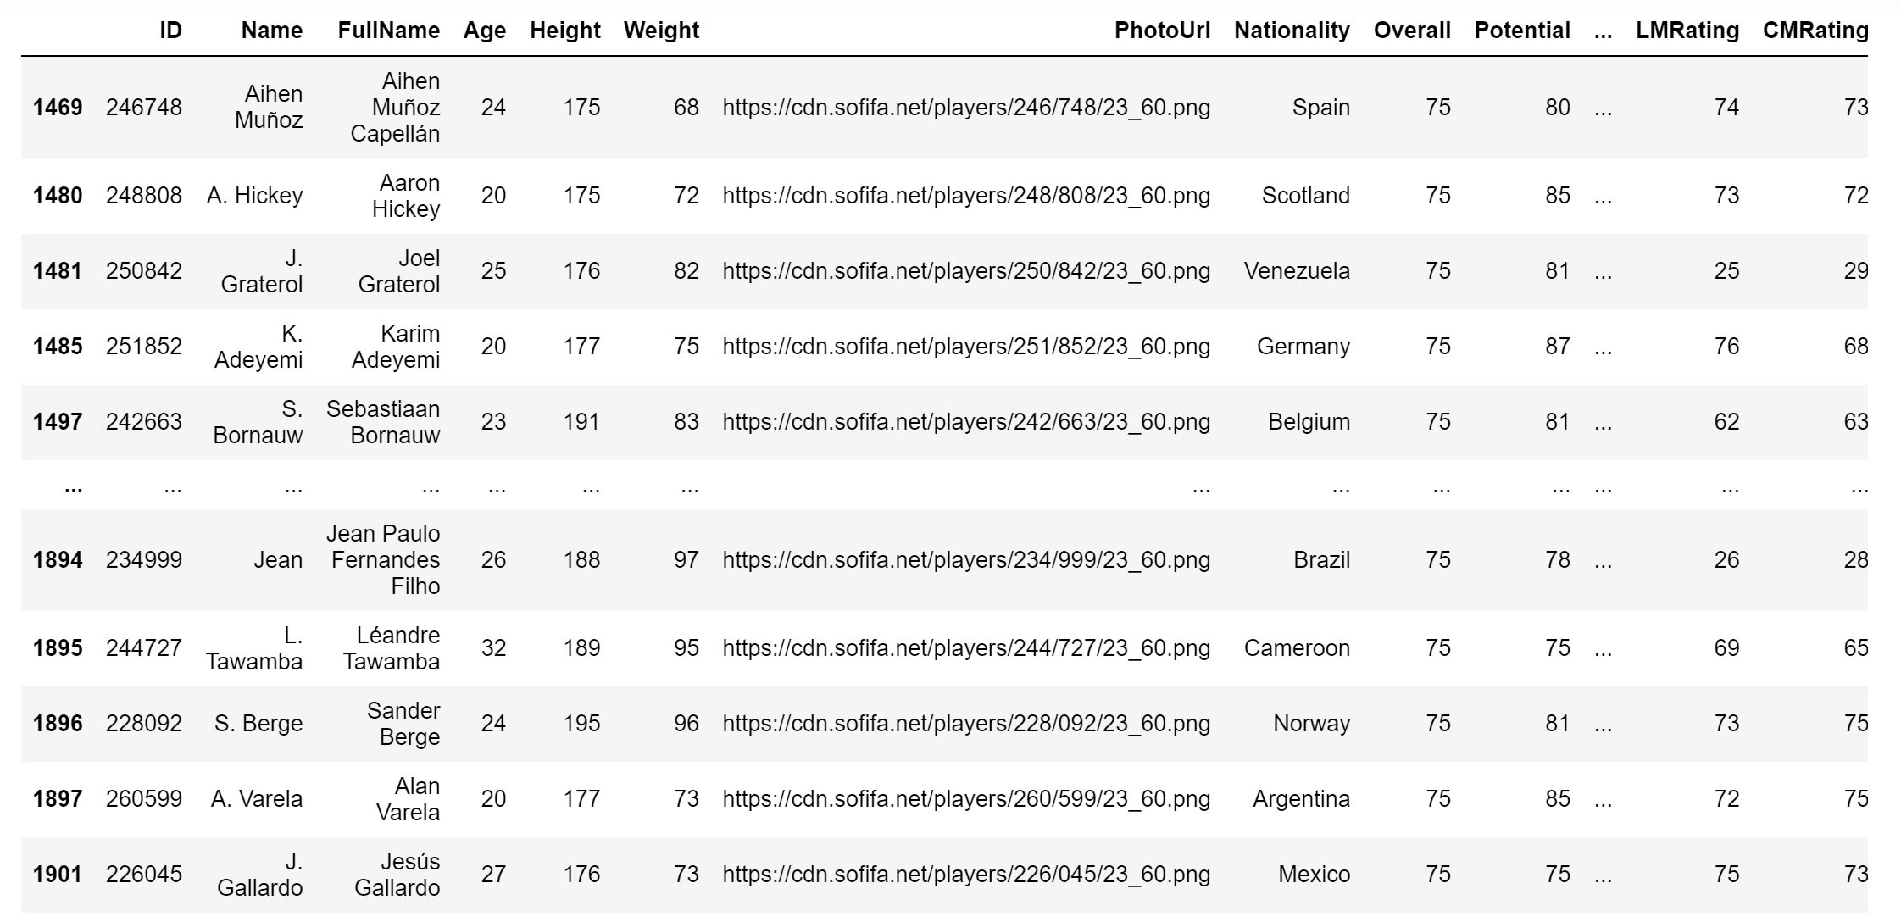
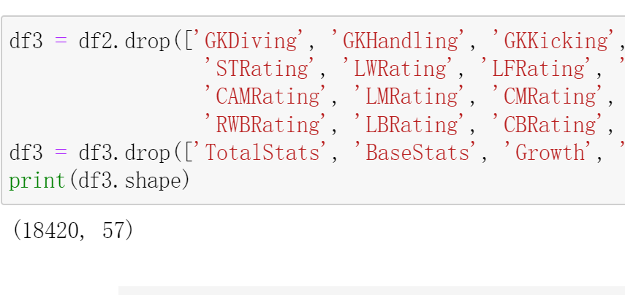
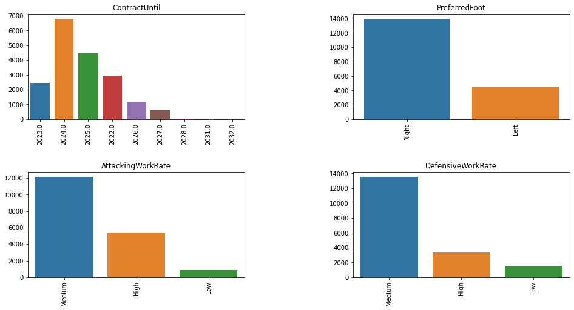
2.2 Cleaning Steps
Refill Missing Values
Delete Duplicates
Remove Unrelevant
Create Dummy Variable

Slide 7
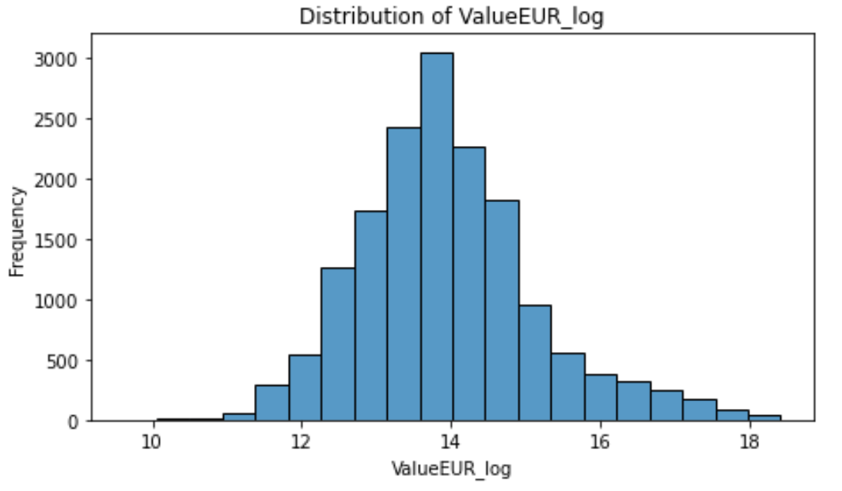
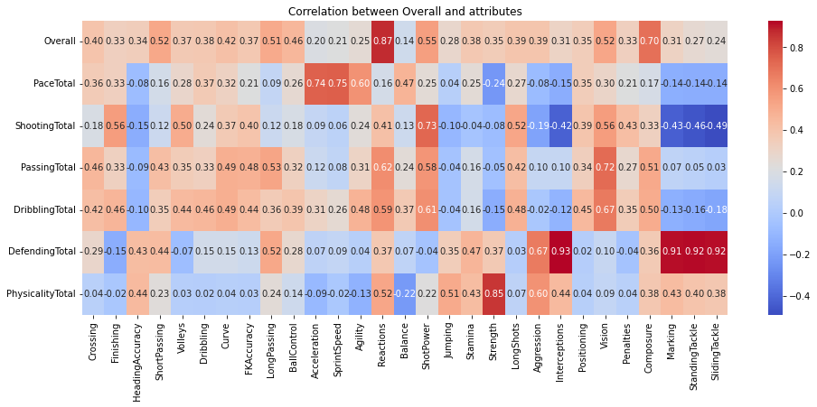
3. Exploratory Data Analysis
Distribution
Correlation

Slide 8
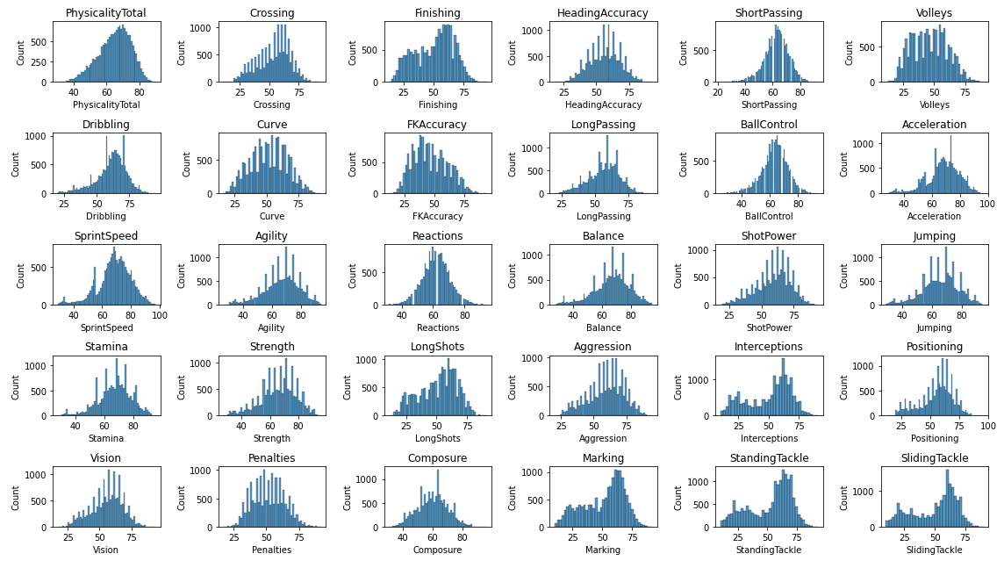
3.1 Checking Distribution

Slide 9
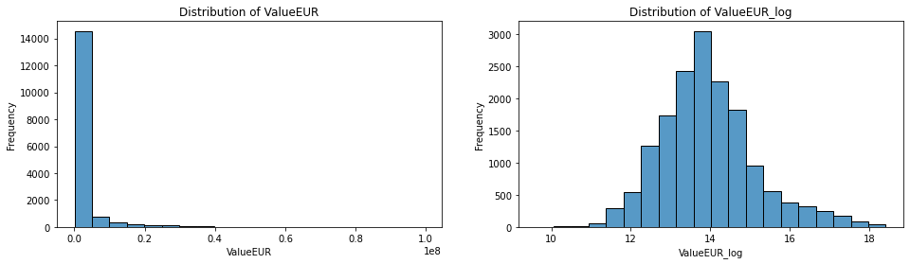
3.1 Checking Distribution
The predicted values are heavily skewed to the left
Most players show very low Market Values
Close to normal distribution after log transformation

Slide 10

3.2 Checking Correlation
General Rating is caculated by Specific Values
We will remove the category ratings to avoid multicollinearity.

Slide 11
4. Regression Modeling
Linear
Models
Linear
RIDGE
LASSO
Multi-
Nominal
non-parametric
Models
Decision Tree
KNN
SVM
Ensemble Models
Random
Forest
Gradient Boosting
Adaboost

Slide 12
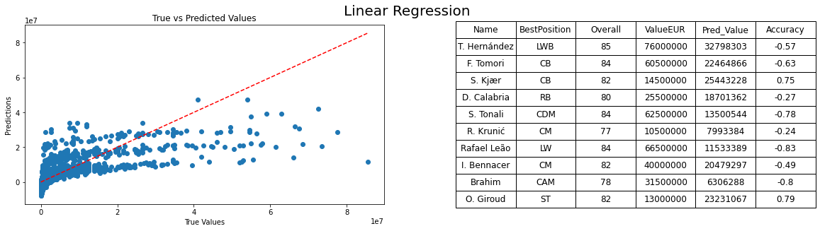
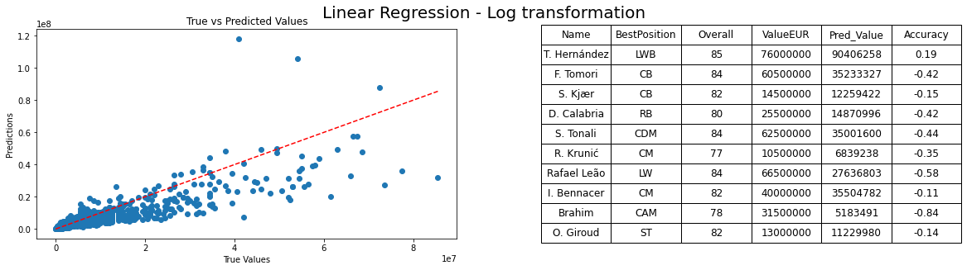
4.1 Linear Regression
Although log transformation improves the performance
Milan players still have an error rate around 40%.
R2 Score: 0.5013
MAE: 2430090
MSE: 21612327480836
Runing: 0.0554 s
R2 Score: 0.7453
MAE: 988093
MSE: 11036989963568
Runing: 0.0419 s

Slide 13
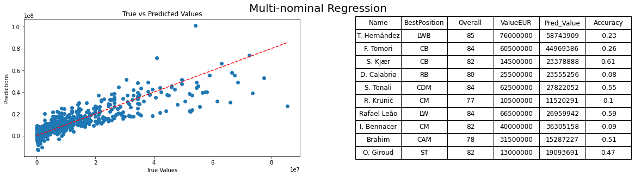
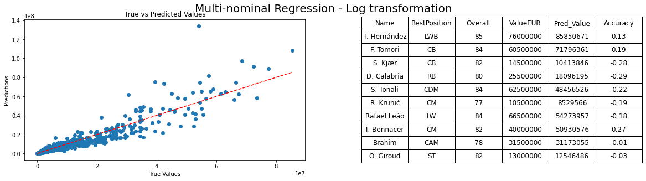
4.2 Multi-nominal Regression
This model fits the market prices of players quite well.
The error of Milan's players is mostly within 20%.
R2 Score: 0.7785
MAE: 1663694
MSE: 9601522135004
Running: 2.1948 s
R2 Score: 0.8763
MAE: 629980
MSE: 5359653235589
Running: 2.5147 s

Slide 14
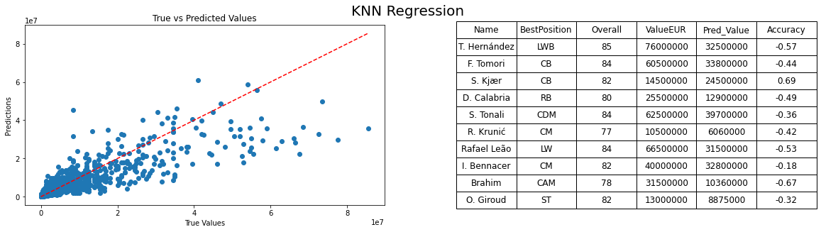
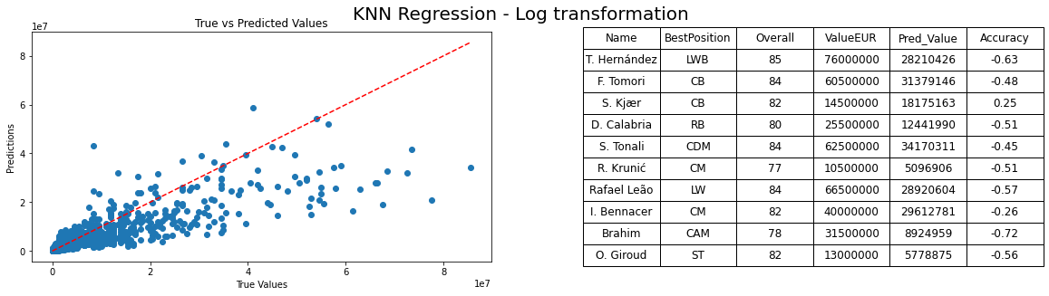
4.3 KNN Regression
Log transformation make the result worse.
Most of the predictions for Milan's players have a significant error.
R2 Score: 0.7428
MAE: 1094924
MSE: 11145900528328
Running: 3.535 s
R2 Score: 0.6932
MAE: 1122900
MSE: 13296664187068
Running: 3.164 s

Slide 15
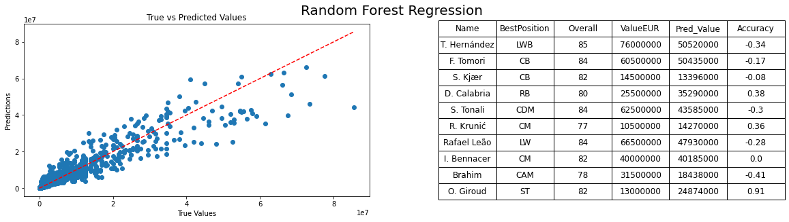
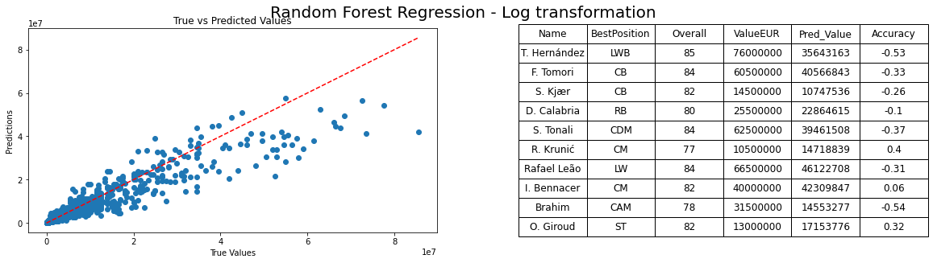
4.4 Random Forest
One of the best model based on the score and MAE
But the predictions for high-value players are inaccurate.
R2 Score: 0.8933
MAE: 697402
MSE: 4623413076250
Running: 57.7969 s
R2 Score: 0.8769
MAE: 679591
MSE: 5334894705692
Running: 52.8876 s

Slide 16
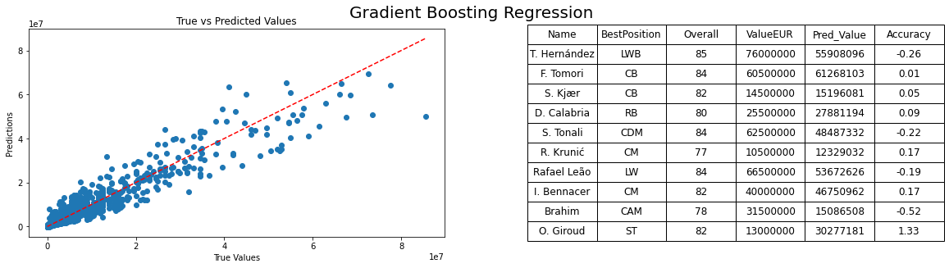
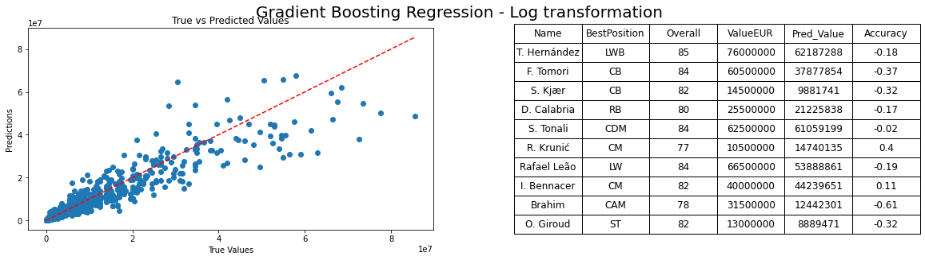
4.5. Gradient Boosting Regression
One of the best model based on the score and MAE
The value of most of Milan's players has been predicted accurately.
R2 Score: 0.9147
MAE: 741671
MSE: 3694760751632
Running: 12.8189 s
R2 Score: 0.8883
MAE: 650905
MSE: 4839335412423
Running: 14.1918 s

Slide 17
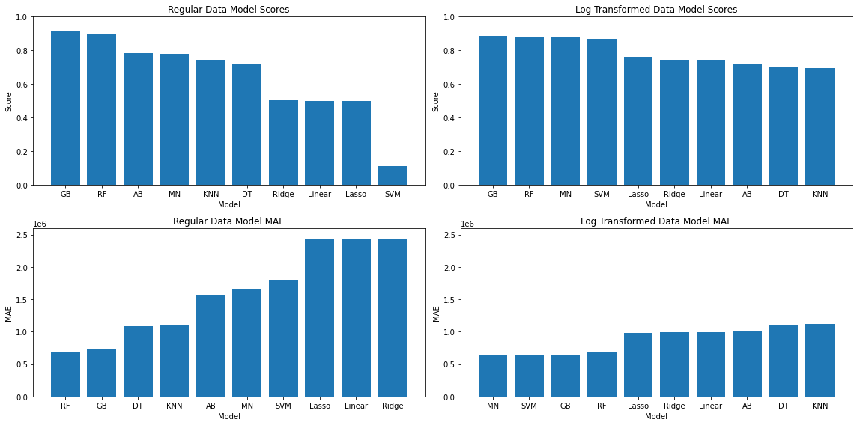
4.6Model Conclusion
Achieving a score of 90% and relatively accurate predictions.
Present the performance of 10 models on the FIFA23 dataset
Sorted from best to worst according to their Score and MAE.

Slide 18
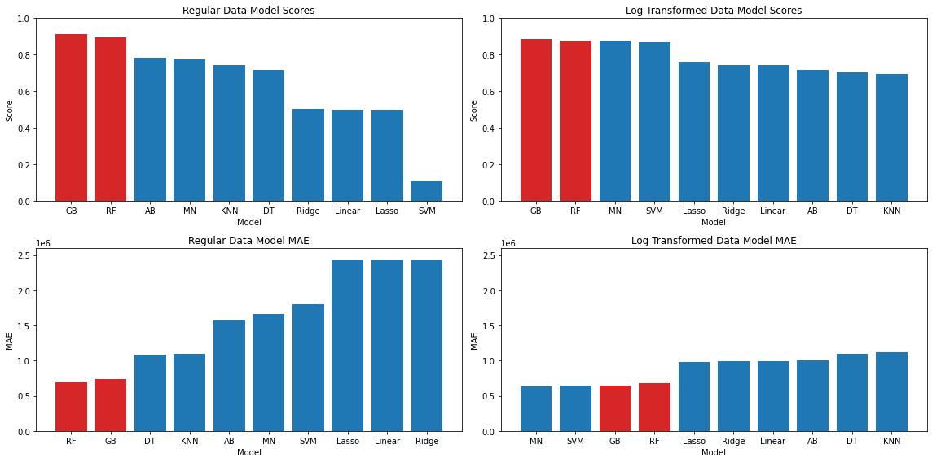
Model Conclusion 1
Gradient Boosting and Random Forest regression models achieve scores of around 90% and low MAE values on both the original and log-transformed targets.

Slide 19
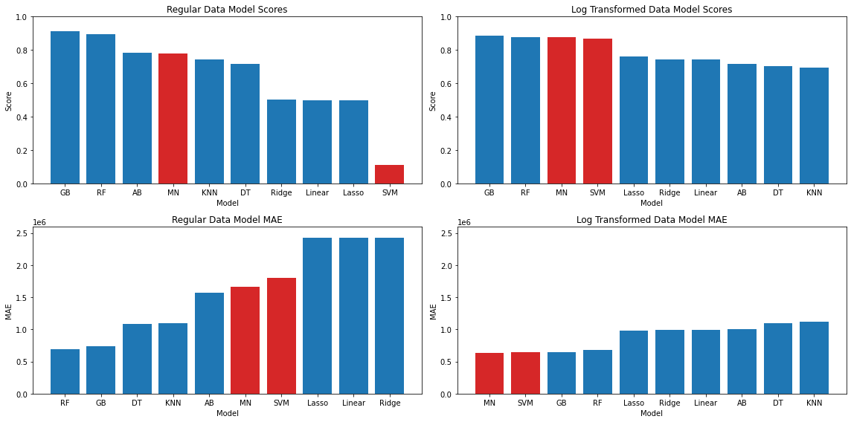
Model Conclusion 2
The Multi-nominal and SVM regression models have the lowest MAE on log transformation, but they perform poorly on the original dataset.

Slide 20
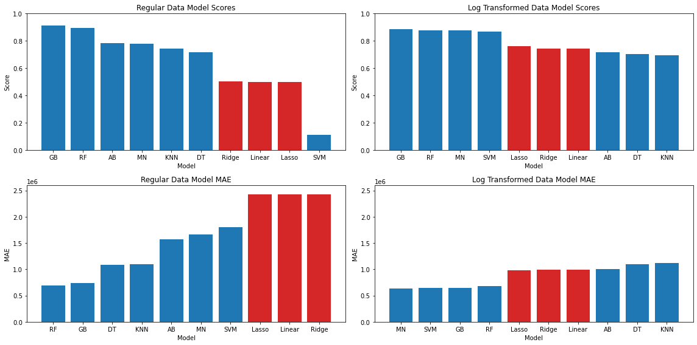
Model Conclusion 3
Although Log transformation improves some performance, Linear regression model fits poorly on this dataset, and neither Ridge nor Lasso provide a significant improvement.

Slide 21
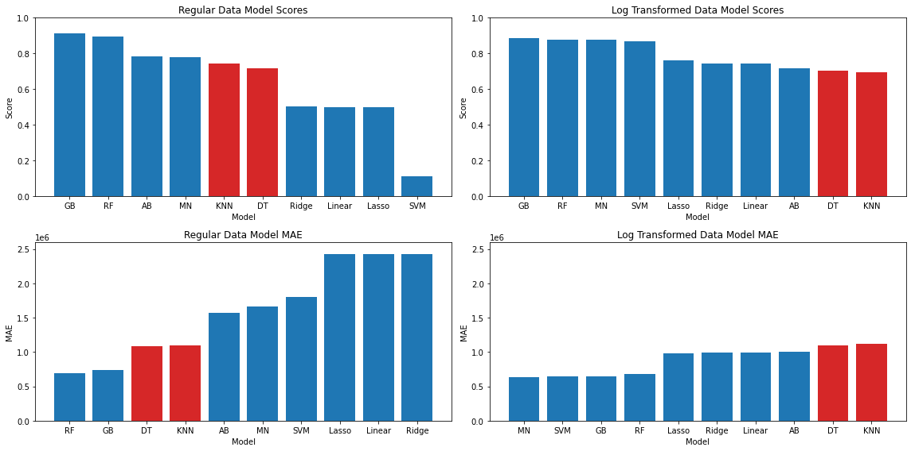
Model Conclusion 4
Decision Tree and KNN regression perform better on the original dataset than on the log-transformed dataset, which means that log transformation still loses some of the original data information.

Slide 22
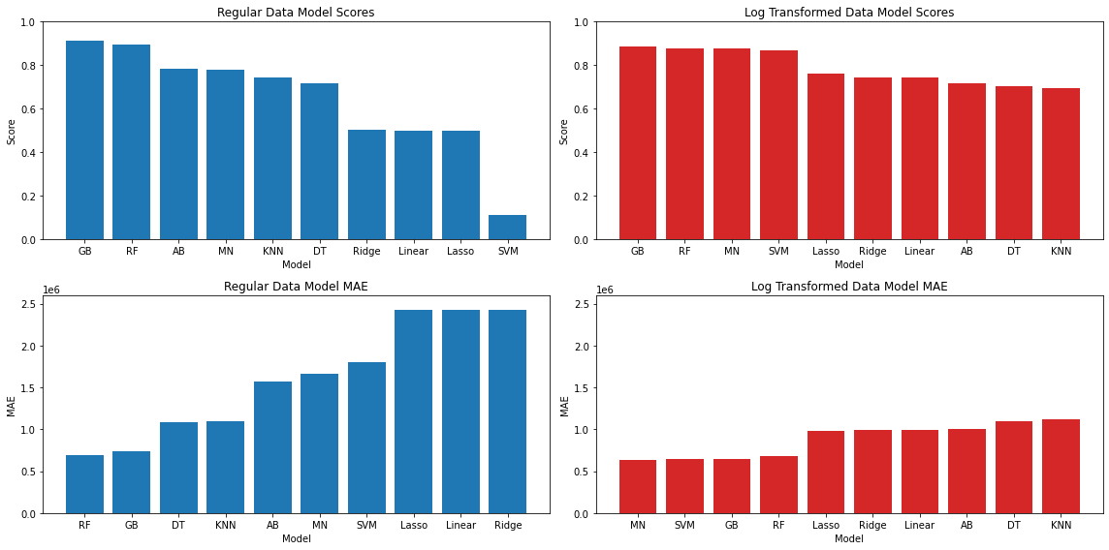
Model Conclusion 5
Overall, the MAE of the models after log transformation is much lower, indicating that log transformation should be considered for variables with severe skewness when performing regression prediction.

Slide 23
5. Final Conclusion
No Free Lunch Theorem
No perfect algorithm, only continuous experimentation to find the best method.
Ensemble Methods
Multiple weak models combined together often result in a stronger model.
Feature Engineering
Right feature leads to the successful result.

Slide 24
Thank you for watching!

